Slide 1
Chapter 2
Objects

Slide 2
Chapter Goals
To learn about variables
To understand the concepts of classes and objects
To be able to call methods
To learn about arguments and return values
To be able to browse the API documentation
To implement test programs
To understand the difference between objects and object references

Slide 3
Objects and Classes
In Java, you build programs for objects.
Each object has certain behaviors.
You can manipulate the object to get certain effects.
Objects are derived from their blueprints - classes

Slide 4
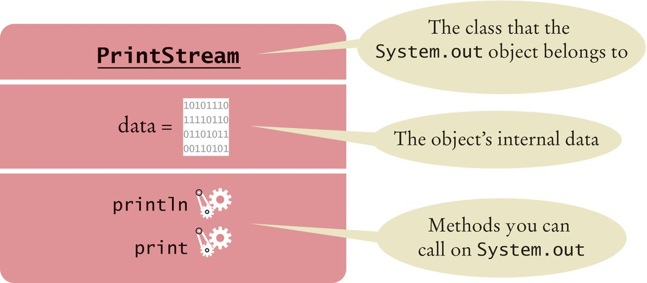
Using Objects
Object: an entity in your program that you can manipulate by calling one or more of its methods.
Method: consists of a sequence of instructions that can access the data of an object.
You do not know what the instructions are
You do know that the behavior is well defined
System.out has a println method
You do not know how it works
What is important is that it does the work you request of it
Figure 1 Representation of the System.out Object

Slide 5
Classes
A class describes a set of objects with the same behavior.
Some string objects
"Hello World" "Goodbye“ "Mississippi"
You can invoke the same methods on all strings.
System.out is a member of the PrintStream class that writes to the console window.
You can construct other objects of PrintStream class that write to different destinations.
All PrintStream objects have methods println and print.

Slide 6
Classes
Objects of the PrintStream class have a completely different behavior than the objects of the String class.
Different classes have different responsibilities
  A string knows about the letters that it contains
  A string doesn't know how to send itself to a console window or file.

Slide 7
Variables
Use a variable to store a value that you want to use later
To declare a variable named width
  int width = 20;
Like a variable in a computer program, a parking space has an identifier and a content.

Slide 8
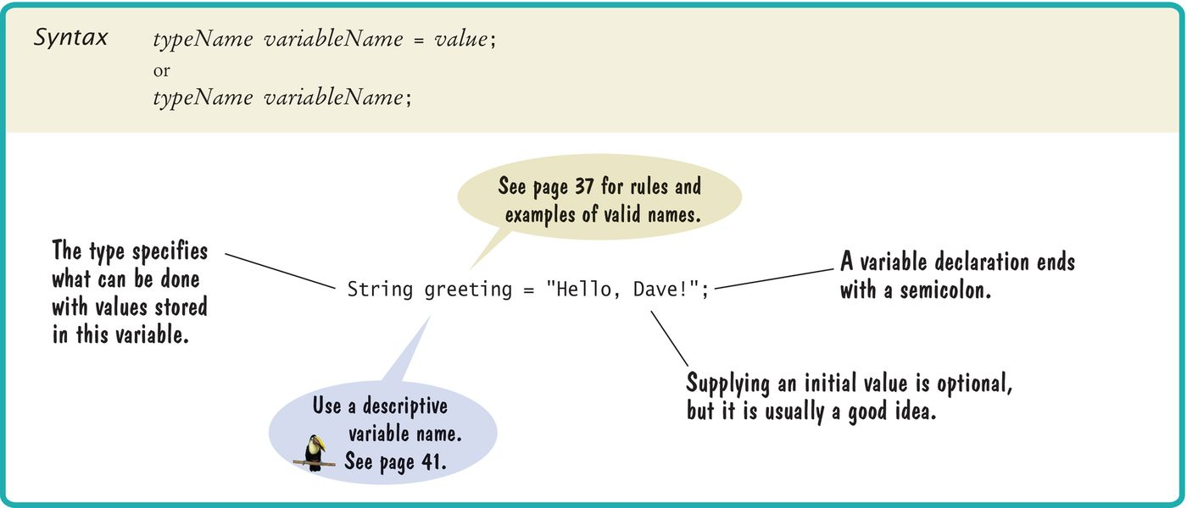
Syntax 2.1 Variable Declaration

Slide 9
Variables
A variable is a storage location
Has a name and holds a value
When declaring a variable, you usually specify an initial value.
When declaring a variable, you also specify the type of its values.
Variable declaration: int width = 20;
width is the name
int is the type
20 is the initial value
Each parking space is suitable for a particular type of vehicle, just as each variable holds a value of a particular type.

Slide 10
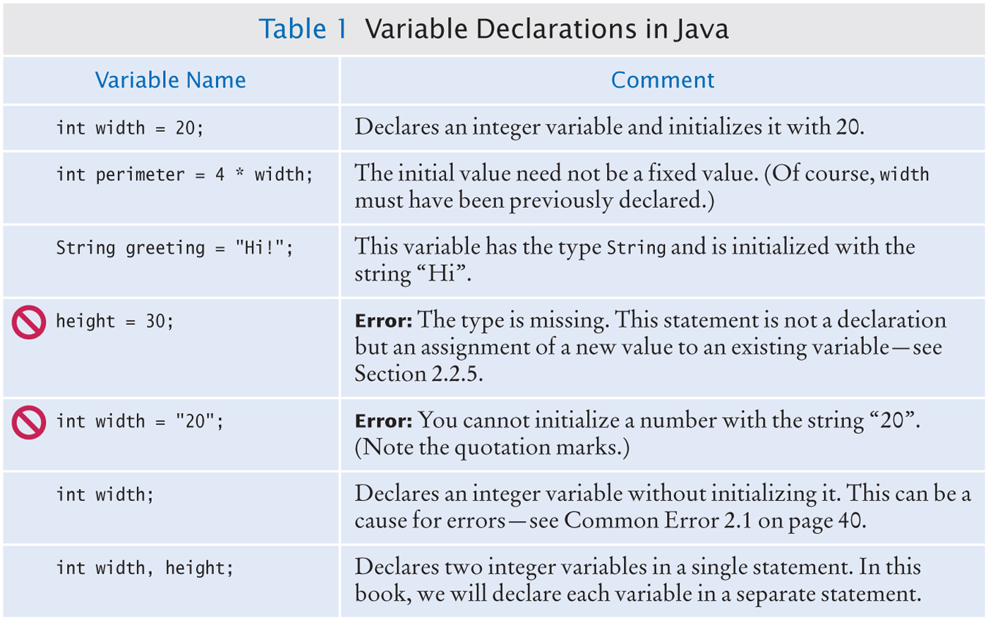
Variable Declarations

Slide 11
Types
Use the int type for numbers that cannot have a fractional part.
int width = 20;
Use the double type for floating point numbers.
double milesPerGallon = 22.5;
Numbers can be combined by arithmetic operators such as +, -, and *
Another type is String
String greeting = "Hello";
A type specifies the operations that can be carried out with its values.
  You can multiply the value width holds by a number
  You can not multiply greetings by a number.

Slide 12
Names
Pick a name for a variable that describes its purpose.
Rules for the names of variables, methods, and classes:
  Must start with a letter or the underscore (_) character, and the remaining characters must be letters, numbers, or underscores.
  Cannot use other symbols such as ? or % or a space
  Use uppercase letters to denote word boundaries, as in milesPerGallon.
  Names are case sensitive
  You cannot use reserved words such as double or class
By Java convention:
  variable names start with a lowercase letter.
  class names start with an uppercase letter.

Slide 13
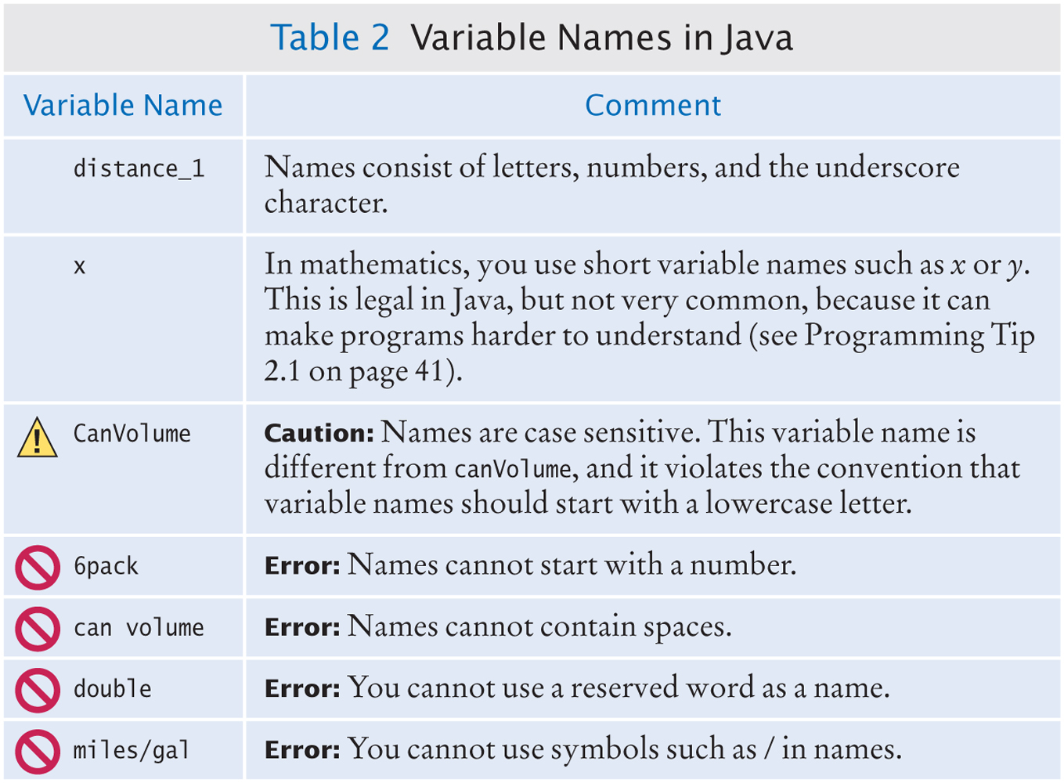
Variable Names in Java

Slide 14
Comments
Use comments to add explanations for humans who read your code.
double milesPerGallon = 33.8;
// The average fuel efficiency of new U.S. cars in 2011
The compiler does not process comments
It ignores everything from a // delimiter to the end of the line.
For longer comment, enclose it between /* and */ delimiters.
The compiler ignores these delimiters and everything in between.
Example of longer comments
/*
In most countries, fuel efficiency is measured in liters per hundred kilometer. Perhaps that is more useful—it tells you how much gas you need to purchase to drive a given distance. Here is the conversion formula.
*/
double fuelEfficiency = 235.214583 / milesPerGallon

Slide 15

Assignment
Use the assignment operator (=) to change the value of a variable.
You have the following variable declaration
int width = 10;
To change the value of the variable, assign the new value
width = 20;
Figure 2 Assigning a New Value to a Variable

Slide 16

Assignment
It is an error to use a variable that has never had a value assigned to it:
int height;
int width = height; // ERROR - uninitialized variable height
The compiler will complain about an "uninitialized variable"
Figure 3 An Uninitialized Variable
Remedy: assign a value to the variable before you use it.
int height = 20;
int width = height; // OK
All variables must be initialized before you access them.

Slide 17
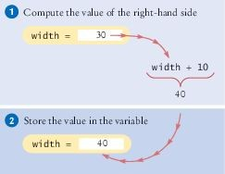
Assignment
The right-hand side of the = symbol can be a mathematical expression:
width = height + 10;
This means
compute the value of height + 10
store that value in the variable width
width = width + 10
The assignment operator = does not denote mathematical equality.
Figure 4 Executing the Statement width = width + 10

Slide 18
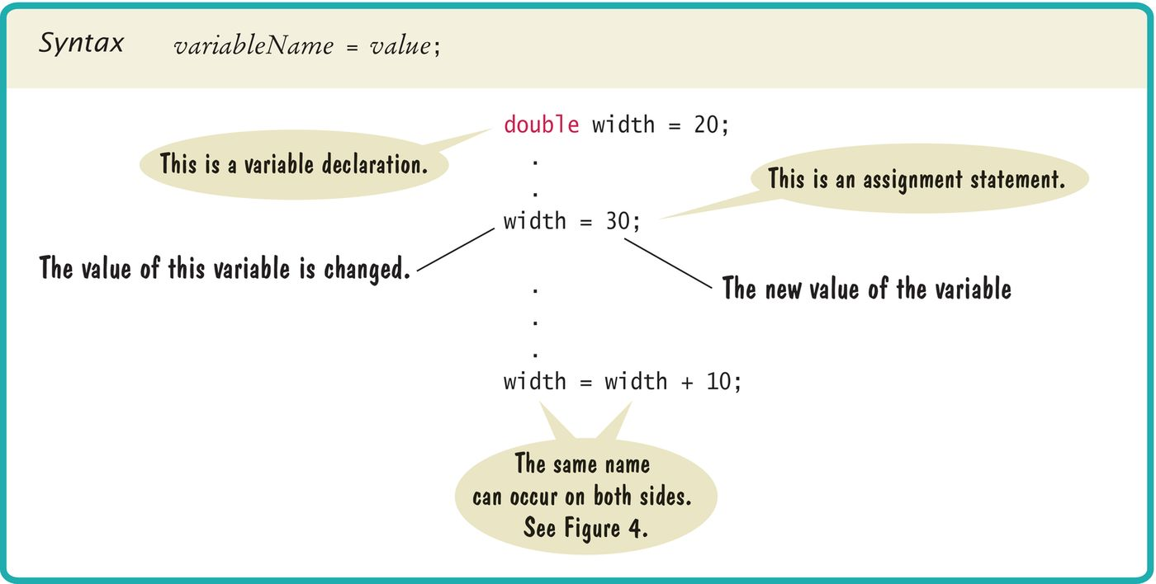
Syntax 2.2 Assignment

Slide 19
Calling Methods
You use an object by calling its methods.
All objects of a given class share a common set of methods.
The PrintStream class provides methods for its objects such as:
println
print
The String class provides methods that you can apply to all String
objects.
Example: length
String greeting = “Hello, World!”;
int numberOfCharacters = greeting.length();
Example: toUpperCase
String river = “Mississippi”;
String bigRiver = river.toUpperCase();

Slide 20
The Public Interface of a Class
The String class declares many other methods besides the length and toUpperCase methods.
Collectively, the methods form the public interface of the class.
The public interface of a class specifies what you can do with its objects.
The hidden implementation describes how these actions are carried out.

Slide 21
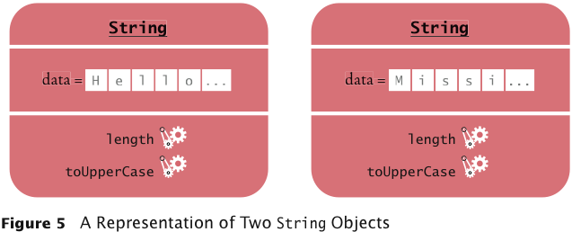
A Representation of Two String Objects
Each String object stores its own data.
Both objects support the same set of methods.
Those methods form the public interface
Public interface is specified by the String class.

Slide 22
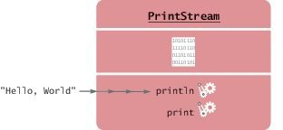
Method Arguments
Most methods require values that give details about the work that the method needs to do.
You must supply the string that should be printed when you call the println method.
The technical term for method inputs: arguments.
The string greeting is an argument of this method call:
System.out.println(greeting);
Figure 6 Passing an Argument to the println Method

Slide 23
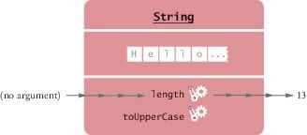
Method Arguments
Some methods require multiple arguments.
Other methods don't require any arguments at all.
  Example: the length method of the String class
  All the information that the length method requires to do its job is stored in the object
Figure 7 Invoking the length Method on a String Object

Slide 24
Return Values
Some methods carry out an action for you.
Example: println method
Other methods compute and return a value.
Example: the String length method
returns a value: the number of characters in the string.
You can store the return value in a variable:
int numberOfCharacters = greeting.length()
The return value of a method is a result that the method has computed.

Slide 25
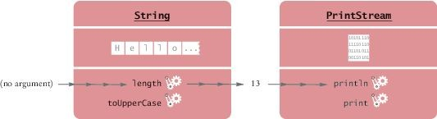
Return Values
You can also use the return value of one method as an argument of another method:
System.out.println(greeting.length());
The method call greeting.length() returns a value - the integer 13. The return value becomes an argument of the println method.
Figure 8 Passing the Result of a Method Call to Another Method

Slide 26
Return Values - replace method
Example: assume
String river = "Mississippi";
Then the statement
river = river.replace("issipp", "our");
Constructs a new String by
Replacing all occurrences of "issipp" in"Mississippi" with "our"
Returns the constructed String object "Missouri"
And saves the return value in the same variable
You could pass the return value to another method:
System.out.println(river.replace("issipp", "our"))

Slide 27
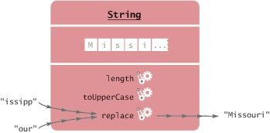
Return Value - replace method - Continued
The method call
river.replace("issipp", "our"))
Is invoked on a String object: "Mississippi"
Has two arguments: the strings "issipp" and "our"
Returns a value: the string "Missouri"
Figure 9 Calling the replace Method

Slide 28
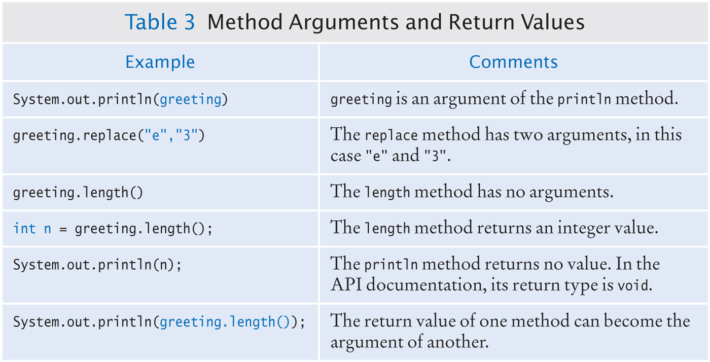
Method Arguments and Return Values

Slide 29
Method Declaration
To declare a method in a class, specify
The types of the arguments
The return value
Example: public int length()
There are no arguments
The return value has the type int

Slide 30
Method Declaration - continued
Example: public String replace(String target, String replacement)
Has two arguments, target and replacement
Both arguments have type String
The returned value is another string
Example: public void println(String output)
Has an argument of type String
No return value
Uses the keyword void

Slide 31
Method Declaration
A class can declare two methods with the same name and different argument types.
The PrintStream class declares another println method
public void println(int output)
Used to print an integer value
The println name is overloaded because it refers to more than one method.

Slide 32

Constructing Objects
Objects of the Rectangle class describe rectangular shapes.

Slide 33
Constructing Objects
The Rectangle object is not a rectangular shape.
It is an object that contains a set of numbers.
The numbers describe the rectangle
Each rectangle is described by:
The x- and y-coordinates of its top-left corner
Its width
And its height.

Slide 34
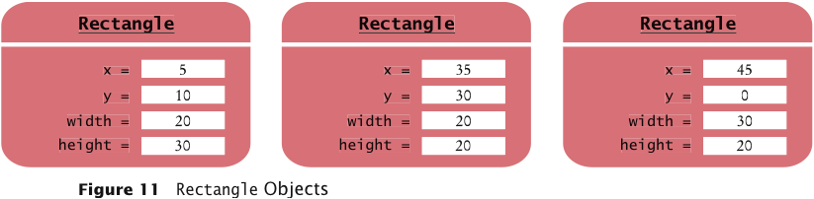
Constructing Objects
In the computer, a Rectangle object is a block of memory that holds four numbers.

Slide 35
Constructing Objects
Use the new operator, followed by a class name and arguments, to construct new objects.
new Rectangle(5, 10, 20, 30)
Detail:
The new operator makes a Rectangle object
It uses the parameters (in this case, 5, 10, 20, and 30) to initialize the data of the object
It returns the object
The process of creating a new object is called construction.
The four values 5, 10, 20, and 30 are called the construction arguments. Usually the output of the new operator is stored in a variable:
Rectangle box = new Rectangle(5, 10, 20, 30);
Additional constructor
new Rectangle()

Slide 36
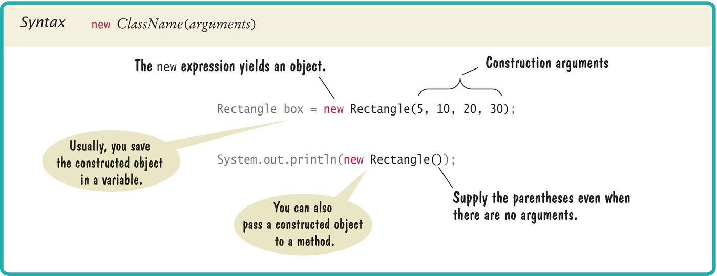
Syntax 2.3 Object Construction

Slide 37
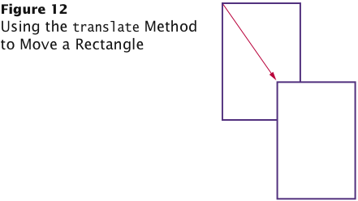
Accessor and Mutator Methods
Accessor method: does not change the internal data of the object on which it is invoked.
Returns information about the object
Example: length method of the String class
Example: double width = box.getWidth();
Mutator method: changes the data of the object
box.translate(15, 25);
The top-left corner is now at (20, 35).

Slide 38
The API Documentation
API: Application Programming Interface
API documentation: lists classes and methods of the Java library
Application programmer: A programmer who uses the Java classes to put together a computer program (or application)
Systems Programmer: A programmer who designs and implements library classes such as PrintStream and Rectangle http://docs.oracle.com/javase/8/docs/api/index.html

Slide 39
Browsing the API Documentation
The detailed description of a method shows:
The action that the method carries out
The types and names of the parameter variables that receive the arguments when the method is called
The value that it returns (or the reserved word void if the method doesn't return any value).

Slide 40
Packages
Java classes are grouped into packages.
The Rectangle class belongs to the package java.awt.
To use the Rectangle class you must import the package:
import java.awt.Rectangle;
Put the line at the top of your program.
You don't need to import classes in the java.lang package such as String and System.

Slide 41
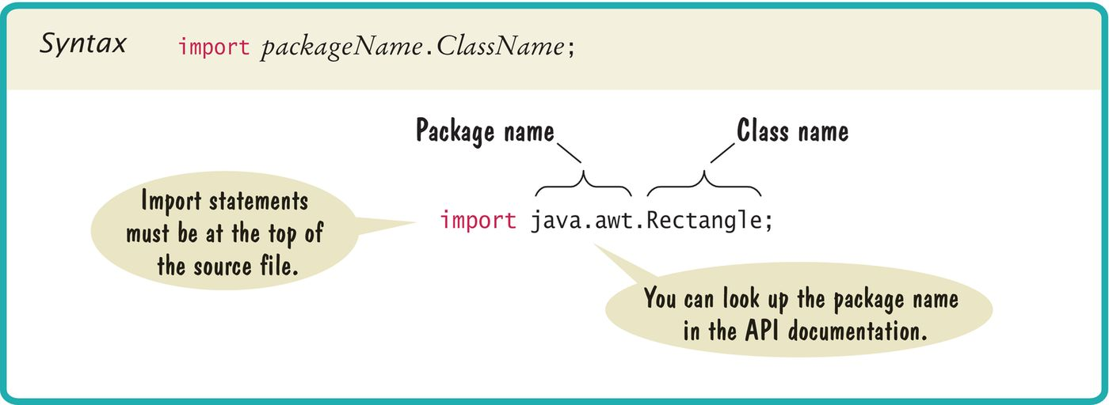
Syntax 2.4 Importing a Class from a Package

Slide 42
Implementing a Test Program
A test program verifies that methods behave as expected.
Steps in writing a tester class
Provide a tester class.
Supply a main method.
Inside the main method, construct one or more objects.
Apply methods to the objects.
Display the results of the method calls.
Display the values that you expect to get.

Slide 43
Implementing a Test Program
Code to test the behavior of the translate method
Place the code inside the main method of the MoveTester class
Determining the expected result in advance is an important part of testing.
Rectangle box = new Rectangle(5, 10, 20, 30);
// Move the rectangle
box.translate(15, 25);
// Print information about the moved rectangle
System.out.print("x: ");
System.out.println(box.getX());
System.out.println("Expected: 20");

Slide 44
MoveTester.java
1 import java.awt.Rectangle;
2
3 public class MoveTester
4 {
5 public static void main(String[] args)
6 {
7 Rectangle box = new Rectangle(5, 10, 20, 30);
8
9
10
11
12
13
14
15
16
17
18
19
20
21 }
// Move the rectangle
box.translate(15, 25);
// Print information about the moved rectangle
System.out.print("x: ");
System.out.println(box.getX());
System.out.println("Expected: 20");
System.out.print("y: "); System.out.println(box.getY()); System.out.println("Expected: 35");
}

Slide 45
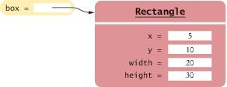
Object References
An object variable is a variable whose type is a class
  Does not actually hold an object.
  Holds the memory location of an object
Figure 15 An Object Variable Containing an Object Reference

Slide 46
Object References
Object reference: describes the location of an object
After this statement:
Rectangle box = new Rectangle(5, 10, 20, 30);
Variable box refers to the Rectangle object returned by the new operator.
The box variable does not contain the object.
It refers to the object.

Slide 47
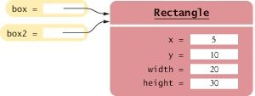
Object References
Multiple object variables can refer to the same object:
Rectangle box = new Rectangle(5, 10, 20, 30);
Rectangle box2 = box;
Figure 16 Two Object Variables Referring to the Same Object

Slide 48
Numbers
Numbers are not objects.
Number variables actually store numbers.
Figure 17 A Number Variable Stores a Number

Slide 49
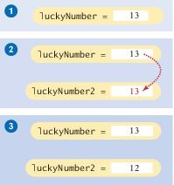
Copying Numbers
When you copy a number
  the original and the copy of the number are independent values.
int luckyNumber = 13;
int luckyNumber2 = luckyNumber;
luckyNumber2 = 12;
Figure 18 Copying Numbers

Slide 50
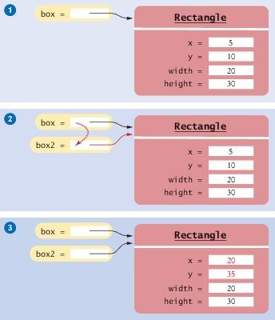
Copying Object References
When you copy an object reference
  both the original and the copy are references to the same object
Rectangle box = new Rectangle(5, 10, 20, 30);
Rectangle box2 = box;
box2.translate(15, 25);
Figure 19 Copying Object References

